Slide 1



DWI Detection & SFST
Instructor
Development
Course
Session 8 – Developing and Using Training Aids
February, 2017

Slide 2

Content Segments
Commonly Used Training Aids
Purposes of Training Aids
Whiteboards, Wall Charts, & Easels/Easel Pads
Audio/Video
Presentation Software Programs
Handouts
Copyright Fundamentals
Questions and/or Concerns
Notes:
Session 8: Developing and Using Training Aids
Estimated time for Session 8: 1 Hour, 30 Minutes (depending on class size)
Session Objectives
Demonstrate the purpose and use of training aids
Plan how you will integrate training aids in your demonstration
Contents
Commonly Used Training Aids
Purposes of Training Aids
Whiteboards, Wall Charts, & Easels/Easel Pads
Audio/Video
Presentation Software Programs
Handouts
Copyright Fundamentals for Presentations
Questions and/or Concerns
Materials
Presentation slides
Remote presenters (if available)
Easel/Easel Pad
Markers
Computer speakers (for embedded videos)
Instructional Notes are presented in bold italic throughout the sessions.

Slide 3

DWI Detection and SFST
Instructor Development Course
Session 8:
Developing and Using Training Aids
Notes:
Session 8: Developing and Using Training Aids
Estimated Time for Session 8: 1 Hour, 30 Minutes
Materials
Presentation slides
Remote presenters (if available)
Easel/Easel Pad
Markers
Computer speakers (for embedded videos)
__________________________________________________________________________
__________________________________________________________________________
__________________________________________________________________________
__________________________________________________________________________
__________________________________________________________________________
__________________________________________________________________________
__________________________________________________________________________

Slide 4

Session Objectives
Demonstrate purpose and use of training aids
Integrate training aids in demonstration
Notes:
Session Objectives
At the conclusion of this session, participants should be able to:
Demonstrate the purpose and use of training aids
Plan how you will integrate training aids in your demonstration
__________________________________________________________________________
__________________________________________________________________________
__________________________________________________________________________
__________________________________________________________________________
__________________________________________________________________________
__________________________________________________________________________
__________________________________________________________________________
__________________________________________________________________________
__________________________________________________________________________
__________________________________________________________________________

Slide 5
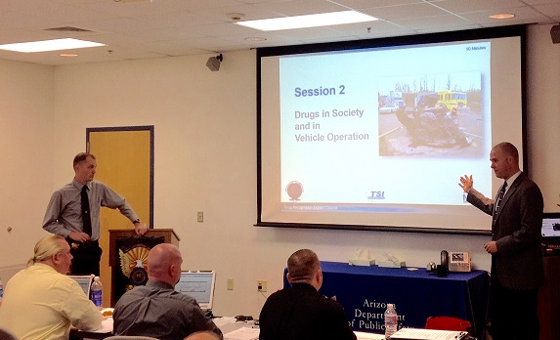
Commonly Used Training Aids
Notes:
A. Commonly Used Training Aids
The instructor should notify participants presentation software programs will not be taught in this course. However, if the participants are interested in learning these programs, the instructor should provide information about other classes or resources.
Instructors are encouraged to bring examples of the various training aids to be used throughout this segment.
Prepared wall charts
Whiteboard or easel/easel pad
Audio/video
Presentation slides
Remote presenters
Handouts
Props
__________________________________________________________________________
__________________________________________________________________________
__________________________________________________________________________
__________________________________________________________________________
__________________________________________________________________________

Slide 6
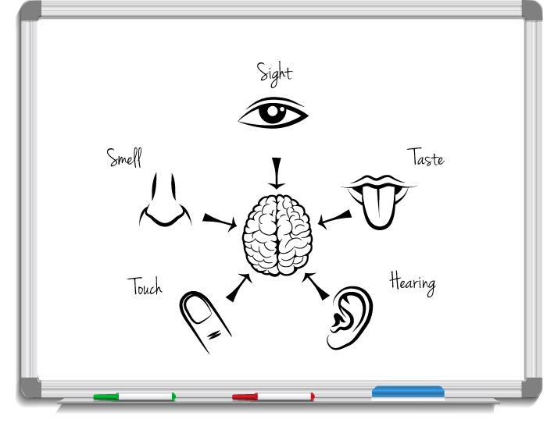
Purposes of Training Aids
Notes:
B. Purposes of Training Aids
Training aids are essential for effective instruction.
Training aids may appeal to multiple senses, including: sight, hearing, smell, taste, and touch
Training aids serve to emphasize key points and help to reinforce participants’ understanding and retention of the material covered
__________________________________________________________________________
__________________________________________________________________________
__________________________________________________________________________
__________________________________________________________________________
__________________________________________________________________________
__________________________________________________________________________
__________________________________________________________________________
__________________________________________________________________________
__________________________________________________________________________

Slide 7

Improper Use of Training Aids
Notes:
Training aids are ineffective if they are not used properly. It is essential instructors prepare before using any training aids. The instructor must:
Be familiar with the type of aid used, its advantages and disadvantages, and methods of implementation
Verify prior to the session all needed equipment is available and in proper working order
Ensure all participants will be able to see and hear the training aid
__________________________________________________________________________
__________________________________________________________________________
__________________________________________________________________________
__________________________________________________________________________
__________________________________________________________________________
__________________________________________________________________________
__________________________________________________________________________
__________________________________________________________________________
__________________________________________________________________________
__________________________________________________________________________

Slide 8

Whiteboards, Wall Charts, & Easels/Easel Pads
Notes:
C. Whiteboards, Wall Charts, & Easels/Easel Pads
Write on a whiteboard or easel/easel pad: Spontaneous Presentations
Reference back to prior use of a easel/easel pad during this course. Note effective color use, size of font, readability, etc.
When the display is no longer needed, it should be erased (or flipped over). If the display is pertinent to the training, it should be displayed on walls, if possible.
Sometimes easels/easel pads can be prepared in advance and still appear spontaneous. Tell the class that easels/easel pads can be easy to use (prior to the session, draw a map (State or U.S.) in light pencil on the chart. Draw faintly, so the lines cannot be seen at a distance. Leave the drawing in front of the class.) Walk up to the chart and trace the map with a thick marker. The class will be impressed in how well you draw the map.
These aids are very useful for spontaneous (actual or perceived) visual aid demonstrations
They can be particularly useful in developing a list of items with a class when the instructor cannot predict what items will be named or in what order they will be named
Make sure the writing is large and clear enough to be seen easily by all participants
Leave material on display long enough to permit participants to take notes
Instructors must not stand in front of the easel/easel pad, obstructing participants’ view
Instructors should not write and talk at the same time

Slide 9

Wall Charts
Notes:
The instructor should also review with the participants the effectiveness of wall charts.
Wall charts:
Very useful for summarizing basic or fundamental information that applies broadly to the entire course of instruction or major segments of it
Can be prepared in advance
Typically left on display for an extended period of time
Should be large enough to be easily seen by all participants
Usually should not occupy the center of visual attention in the classroom; the center should be reserved for the screen and easel/easel pad
Examples of information well suited to presentations via wall charts include:
Training objectives
Outline of training content and/or schedule
Key definitions (e.g., Blood Alcohol Concentration )
Major themes or blocks of instruction
__________________________________________________________________________
__________________________________________________________________________
__________________________________________________________________________
__________________________________________________________________________
__________________________________________________________________________

Slide 10

Audio/Video
Notes:
D. Audio/Video
Always preview audio/video before showing to participants.
Ensure compatibility of audio/video playback equipment with media format
Ensure the format can be seen and heard by all participants in all parts of the room
All instructors must be conscious of how the audio or video may affect participants. If the content is potentially disturbing, instructors may want to provide an advisory warning regarding the content. Give participants the option to leave the room during the playing of the audio or video.
Always discuss the presentations: do not simply show them and move on.
Make sure the audio/video is relevant to the instruction/topic. As a reminder, any outside videos/DVDs not provided as part of the NHSTA/IACP- approved curriculum must be pre-approved by the SFST course manager or training coordinator.
__________________________________________________________________________
__________________________________________________________________________
__________________________________________________________________________
__________________________________________________________________________
__________________________________________________________________________

Slide 11

Presentation Software Programs
Notes:
E. Presentation Software Programs
Conduct activity prior to revealing video (if time allows).
Discussion: Ask the participants to give examples of an ineffective use of presentation software programs. Examples may include:
Too much content on slide
Ineffective use of color/font
Inability to be spontaneous in response to participants
Reading the slides to the audience
Discussion: Ask the participants to give examples of effective use of presentation software programs:
One idea per slide
Simplify text
Use big images
There are many different types of presentation software programs like PowerPoint, Keynote, Prezi, etc. They permit visual slide presentations that emphasize the instructor’s points.
These aids offer word processing, outlining, drawing, graphing, and presentation management tools. A presentation is made up of a series of slides. Slides may contain video, words, photos, sounds, animations, and transitions. In addition to slides, these programs allow users to print handouts, outlines, and instructor’s notes.
As a reminder, any outside PowerPoints not provided as part of the NHSTA/IACP-approved curriculum must be pre-approved by the SFST course manager or training coordinator.

Slide 12
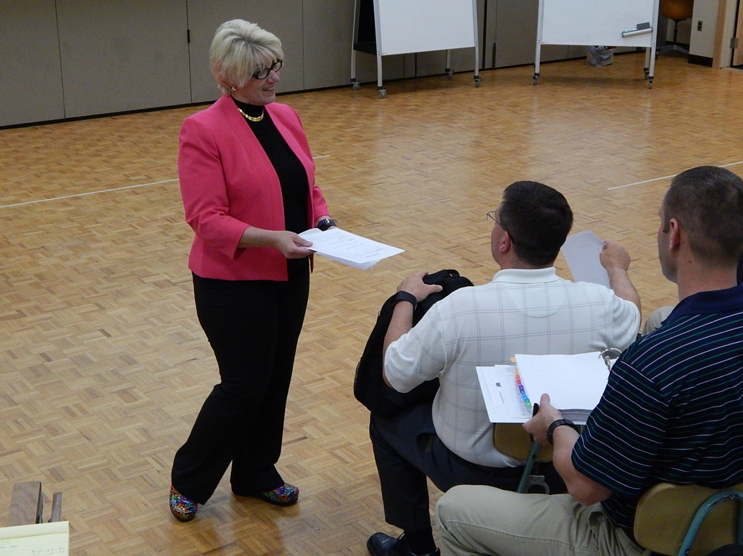
Handouts
Notes:
F. Handouts
Handouts are written or typed materials prepared in advance and distributed to participants during or after a class.
Instructors may consider various forms in which handouts can be printed, including:
Notes pages
Handouts with incomplete information to be filled out by participants during the presentation
Outline form
Color/images
Potential pitfalls:
Expense
Not preferred method of take-home materials (Jump drive, cloud storage, etc., may be preferable)
Can be cumbersome for instructor
Handouts are particularly useful if an instructor wants participants to:
Be able to use the information at a later time
Access and study information at their own pace
Facilitate note-taking
Have participants reflect on training aids they want to use in their final demonstration. Allow participants additional time to write down how they plan to utilize these aids. The instructor at each table should facilitate this process.
As a reminder, any outside handouts not provided as part of the NHSTA/IACP-approved curriculum must be pre-approved by the SFST course manager or training coordinator.

Slide 13

Copyright Fundamentals for Presentations
Notes:
G. Copyright Fundamentals for Presentations
Note some of the fundamental copyright topics participants will need to familiarize themselves with as they prepare presentations. Those topics include: What is protected?; What is not protected?
The instructor is not expected to give a detailed presentation on copyright. The goal of this section is to give the participant awareness and resources to investigate further. Reference citations have been included for further research or study by participants.
Using a picture, movie clip, sound bite, phrase, or similar recorded form or expression (work) in presentations may be restricted under federal copyright law. Essentially any picture, movie clip, sound bite, or phrase that did not originate with the trainer or presenter is likely owned by someone else. Therefore, using it is prohibited unless it is in the public domain. The use would be considered “fair use” under the law or the presenter obtains permission from the owner. Note that simply because the work can be found on the internet does not mean it is in the public domain. Go to www.copyright.gov/fair-use for more information.
What is protected?
Federal copyright law protects “original works of authorship” recorded in any tangible form, including compilations and derivative works. (See 17 U.S.C. §§102-103.) While Congress did not define “original works of authorship,” at a minimum it includes still pictures, movie clips, literary works, and any sound recordings. Only the owner or original author has the right to display, distribute, perform, or reproduce his or her work and prevent others from doing so or modifying the original. See 17 U.S.C. §§106-106A. In essence, unless the presenter or instructor created the work, it is someone else’s original work of authorship.
________________________________________________________________________________________
________________________________________________________________________________________
________________________________________________________________________________________

Slide 14

Copyright Fundamentals for Presentations
Notes:
What is not protected?
Federal copyright law does not protect concepts, ideas, discoveries, procedures, processes, systems, or methods of operation no matter how they are described, explained, or illustrated. (See 17 U.S.C. §102.) For example, if the instructor discusses a new idea with a colleague for DRE testing, the idea in that form has no copyright protection. In addition, the law does not prohibit use of works authored and published by the United States Government or its employees. (See 17 U.S.C. §105.) Meaning, National Highway Traffic Safety Administration (NHTSA) publications can be freely copied, distributed, and reproduced.
While the U.S. Government generally does not obtain ownership rights for works it produces, it can receive and hold copyrights that are transferred to it by someone with ownership rights. Instructors should learn if the government work they intend to use in the presentation is protected by copyright. Generally, government publications will have a statement indicating whether the work is protected by copyright. The instructors should verify whether the work is protected by copyright and, if so, obtain permission of the government or have an exception to the prohibition on display and/or distribution of copyrighted works to use it.
________________________________________________________________________________________
________________________________________________________________________________________
________________________________________________________________________________________
________________________________________________________________________________________
________________________________________________________________________________________
________________________________________________________________________________________

Slide 15

Questions and/or Concerns
Notes:
H. QuestionS AND/OR CONCERNS
Solicit questions and comments from participants before moving to the next Session.
__________________________________________________________________________
__________________________________________________________________________
__________________________________________________________________________
__________________________________________________________________________
__________________________________________________________________________
__________________________________________________________________________
__________________________________________________________________________
__________________________________________________________________________
__________________________________________________________________________
__________________________________________________________________________
__________________________________________________________________________

